Slide 1
E-WI系统使用指南 E-WI System Instruction
Released in : 2023/06/08
Issued by: Anly Hu
PCBA B17 QA

Slide 2
Introduction Content 使用指南内容
1 | System Purpose 系统目的
2 | System Scope 系统范围
3 | System Application 系统用户权限申请
4 | System Using Process 系统使用步骤
4.1 How to view documents in E-WI system？ 如何在E-WI系统里面查看文件？
4.2 How can the production line view WI quickly? 产线如何快捷查看文件？
4.3 Dummy assembly number rule 虚拟料号命名规则
Page 4
Page 6
Page 8~12
Page 14~26
Page 14~23
Page 24
Page 25~26

Slide 3
System Purpose 系统目的

Slide 4
System Purpose 系统目的
Back
Complete the release and viewing of production line documents through the E-WI system.
通过E-WI系统来完成产线文件的释放和查看。
Ensuring that the entire process of file release and file review is completer and more systematic.
确保文件释放和文件查看的整个流程更加完整和系统化。
Use the E-WI system to replace paper documents, reduce the use of paper and ink cartridges, improve the efficiency of document distribution, and protect the environment.
使用E-WI系统代替纸档文件，减少纸张和墨盒的使用，提高文件发放的效率，保护环境。

Slide 5
System Scope 系统范围

Slide 6
System Scope 系统范围
Back
E-WI system applies for releasing and viewing documents of Flex Mechanical, PCBA-B15, PCBA-B17& Rock Functions.
E-WI系统适用于Flex Mechanical, PCBA-B15, PCBA-B17& Rock Functions的文件释放和查看。

Slide 7
System Application 系统用户权限申请

Slide 8
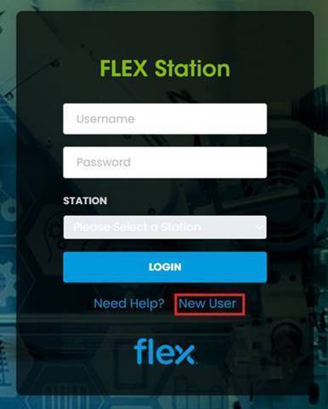
System Application 系统用户权限申请
User ID Management 用户帐号管理
User follow below steps to request Individual account of E-WI system.
用户按照以下步骤申请系统E-WI个人账号。
1. Enter E-WI login page, click on “New User” button.
在登录E-WI界面，点击“新用户”按扭。
https://flexstation.flex.com:8443/ewi/#/flexstation

Slide 9
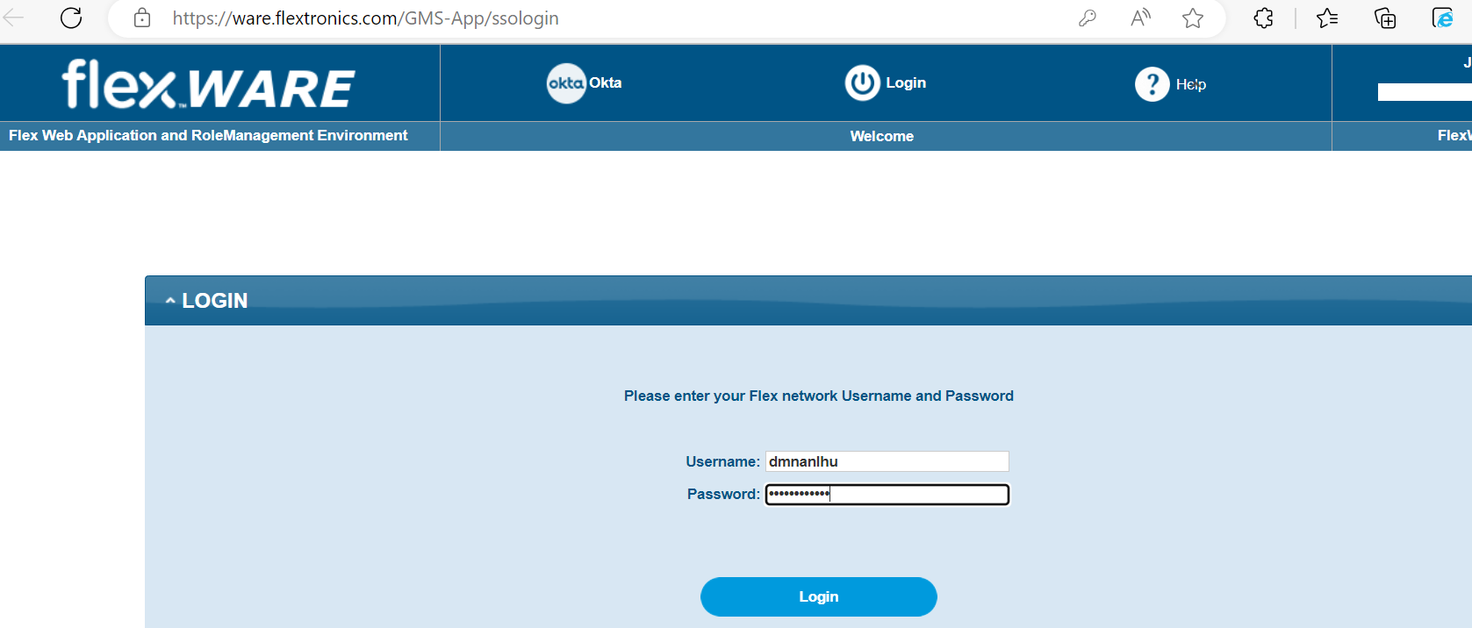
System Application 系统用户权限申请
2. Enter your AD account and password and click "Login" to log in.
输入您的AD账号密码，点击“Login”登陆。
Step 1
Step 2

Slide 10
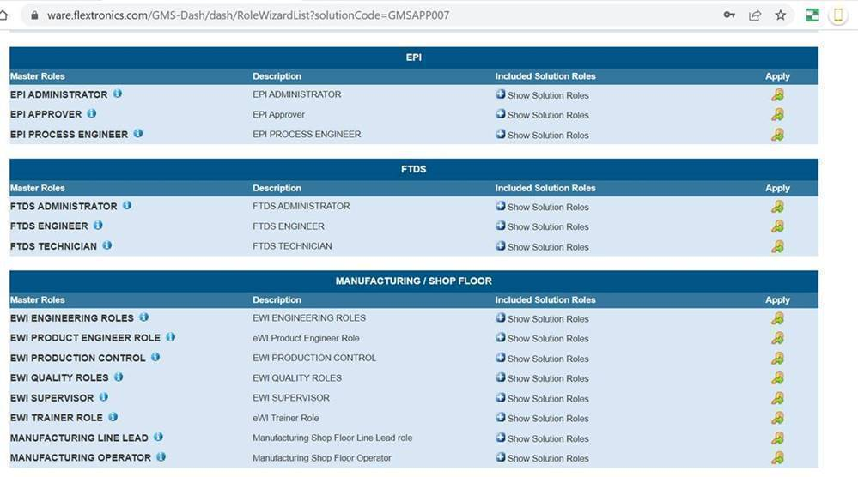
System Application 系统用户权限申请
3. This will redirect into below Flexware Page once after login with your AD.
使用您的AD登录后，将出现下面Flexware界面。

Slide 11
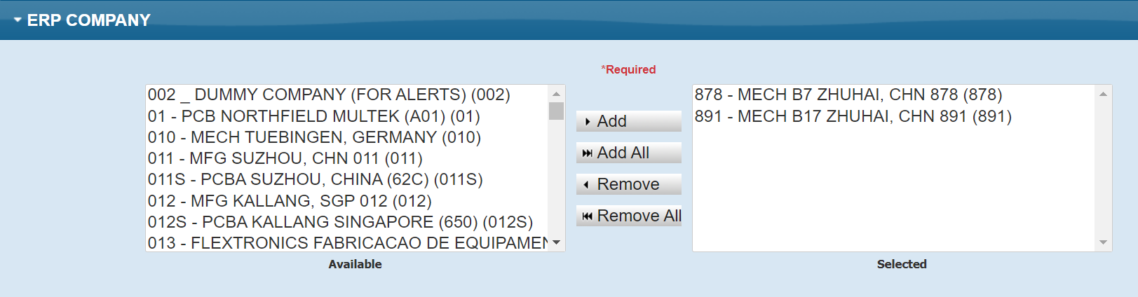
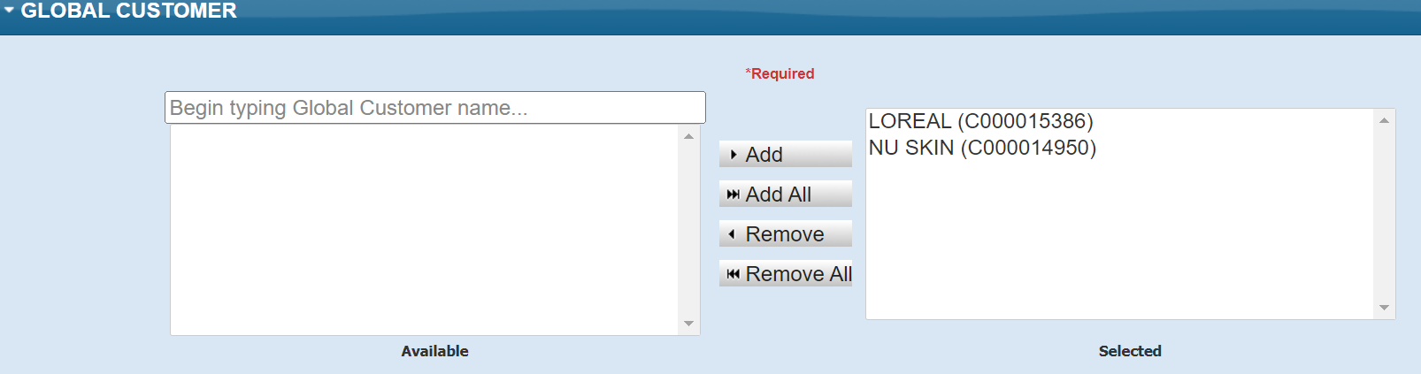
System Application 系统用户权限申请
4. Select the respective E-WI role and click on this to apply and then click next to select and add your site ERP and customer for which you need access to E-WI).
选择相应的 E-WI 角色并单击此应用，然后单击下一步选择并添加您需要访问 E-WI 的事业部 ERP 和客户。
B17用户可选择891 – MECH B17 ZHUHAI
相应的客户名会在此显示
在此处输入需要E-WI权限的项目名称，点击Add

Slide 12
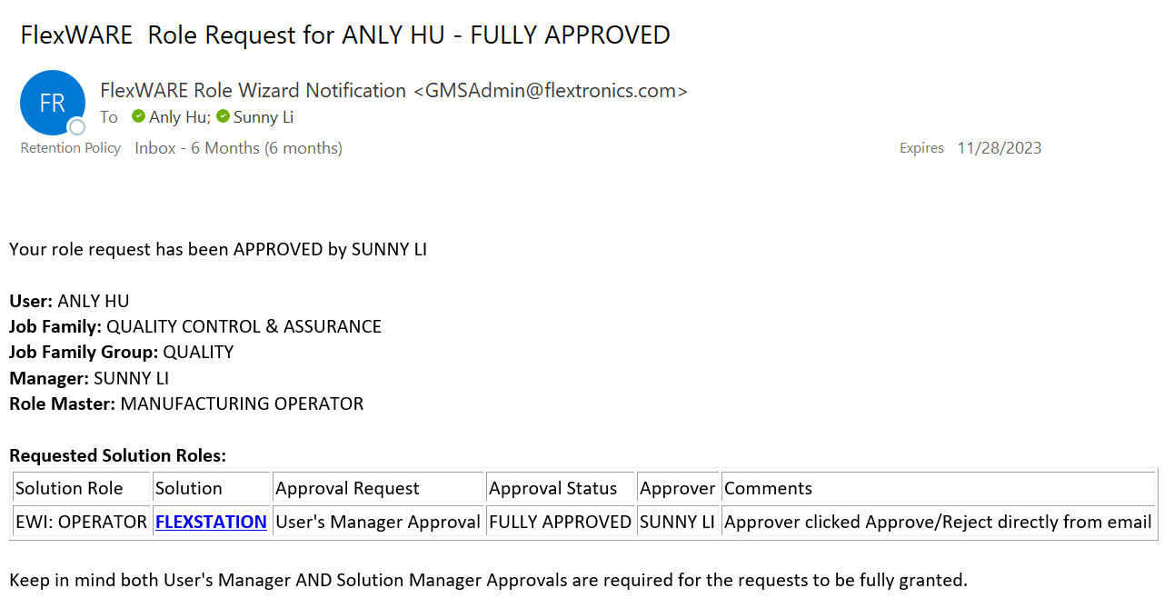
System Application 系统用户权限申请
Back
5. Click on Submit for approvals. Once user manager approve the role, then user can get E-WI access.
点击提交进行审批。一旦用户经理批准角色，该用户就可以获得 E-WI 访问权限。
会收到邮件通知你已经获得E-WI 访问权限

Slide 13
System Using Process 系统使用步骤

Slide 14
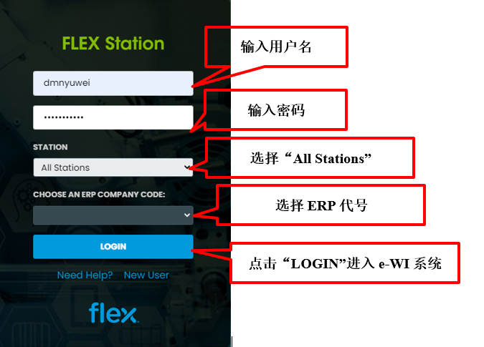
System Using Process 系统使用步骤
How to view documents in E-WI system？ 如何在E-WI系统里面查看文件？
1. The user login E-WI system and follow right steps to login in.
用户登陆E-WI系统，按照右边步骤登陆系统。

Slide 15
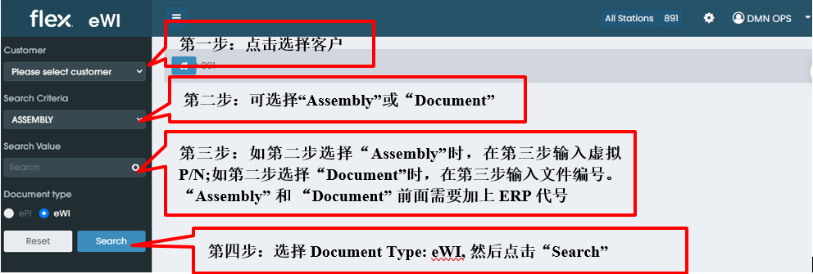
System Using Process 系统使用步骤
How to view documents in E-WI system？ 如何在E-WI系统里面查看文件？
2. Follow below steps to view the related stations documents..
根据以下步骤查看相应工位的文件。

Slide 16
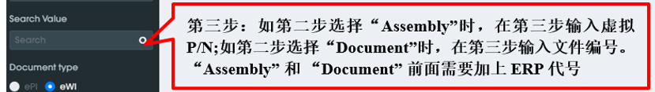
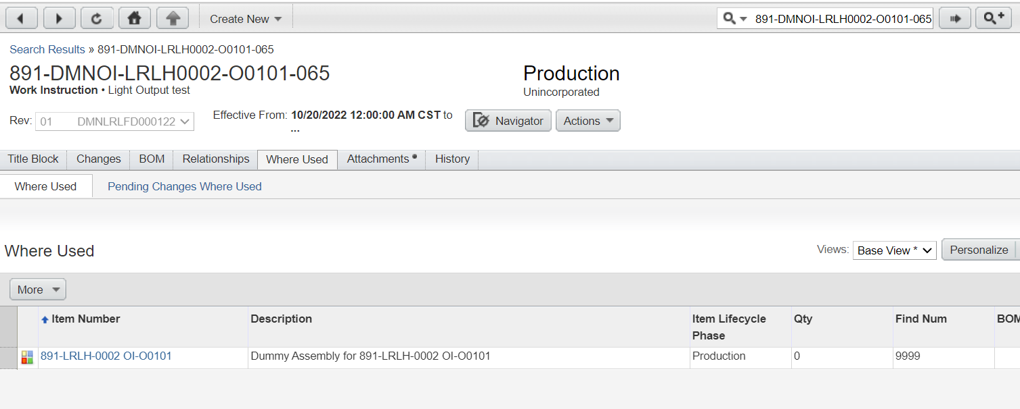
System Using Process 系统使用步骤
How to view documents in E-WI system？ 如何在E-WI系统里面查看文件？
3. For the third step, the detailed explanation is as follows:
针对第三步，详细解释如下：
If you select "Assembly" in the second step, you need to enter the virtual P/N in the third step. The virtual P/N can be viewed in the Agile system. For the entry method of the Agile system, please refer to the "Agile System Instruction"
如第二步选择“Assembly”时，在第三步需要输入虚拟的P/N，虚拟的P/N可以在Agile系统里面查看，Agile系统的进入方式可参看“Agile系统使用指南”
Step 1：在Agile系统搜索栏输入文件编号或OI编号，要在编号前加上前缀ERP代号，B17的项目统一为891-
Step 2：点击“Where Used”
Step 3：查看Item Number, 这个Item Number就是虚拟的P/N，将此Item Number输入E-WI系统Search Value栏

Slide 17
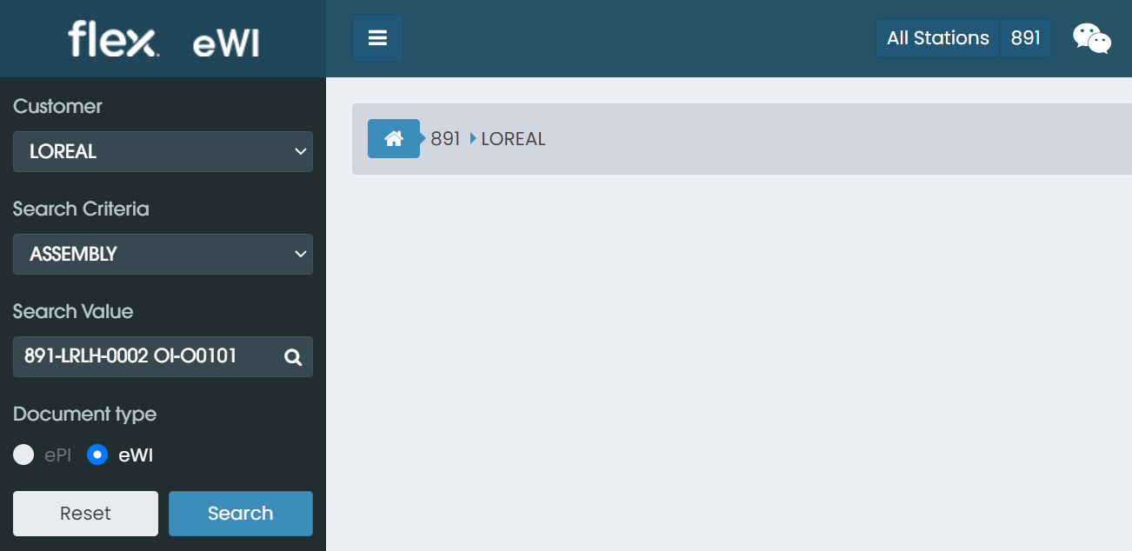
System Using Process 系统使用步骤
How to view documents in E-WI system？ 如何在E-WI系统里面查看文件？
3. For the third step, the detailed explanation is as follows:
针对第三步，详细解释如下：
After selecting Assembly, enter the virtual P/N into the search value column, and click search.
选择Assembly后，将虚拟的P/N输入search value栏，然后点击search。
Step 1：选择“Assembly”
Step 2：输入在Agile系统查到的虚拟P/N，注意P/N的前后都不能有空格
Step 3：点击Search

Slide 18
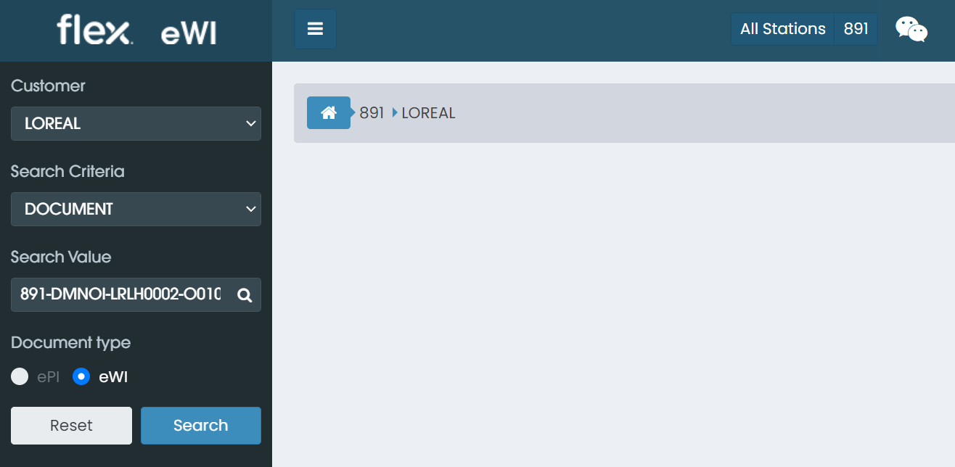
System Using Process 系统使用步骤
How to view documents in E-WI system？ 如何在E-WI系统里面查看文件？
3. For the third step, the detailed explanation is as follows:
针对第三步，详细解释如下：
If you choose "Document" in the second step, you need to enter the document number or OI number in the third step, and you need to add the ERP code in front, and the B17 items are unified as 891-
如第二步选择“Document”时，在第三步需要输入文件编号或者OI编号，前面需要加上ERP代号，B17的项目统一为891-
Step 1：选择“Document”
Step 2：输入文件编号或者OI编号，前面需要加上ERP代号，B17的项目统一为891-
Step 3：点击Search

Slide 19
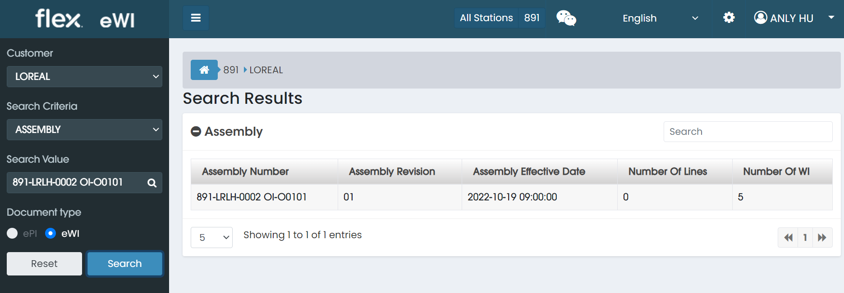
System Using Process 系统使用步骤
How to view documents in E-WI system？ 如何在E-WI系统里面查看文件？
4. When selecting Assembly, the virtual P/N comes out after the search.
当选择Assembly时，search之后出来的是虚拟的P/N.
Step 1：双击assembly number
这里可以看到这个虚拟的P/N下面有5份WI

Slide 20
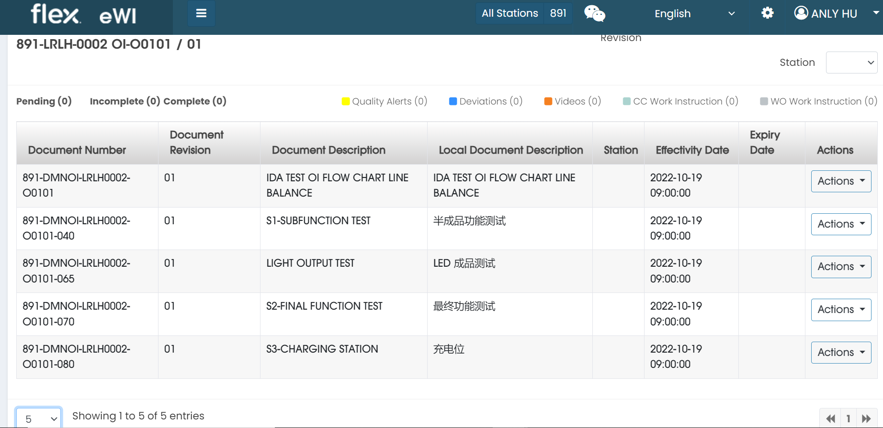
System Using Process 系统使用步骤
How to view documents in E-WI system？ 如何在E-WI系统里面查看文件？
Step 2: 双击assembly number之后，虚拟P/N下面的5份WI都会出现
Step 4: 双击需要查看的文件
Step 3: 如果这个虚拟P/N下面有更多文件，可以选择数字10,25,50等，以便页面显示更多份文件

Slide 21
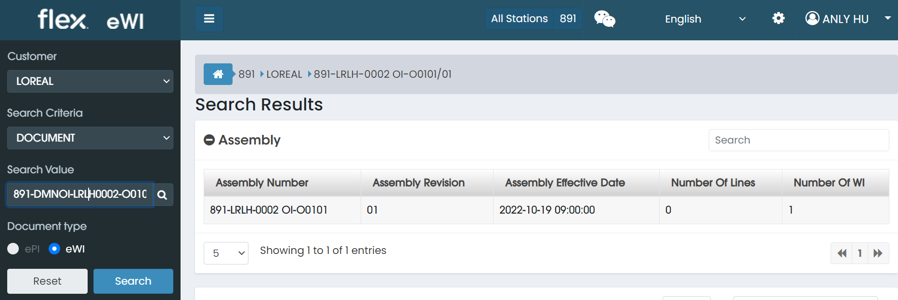
System Using Process 系统使用步骤
How to view documents in E-WI system？ 如何在E-WI系统里面查看文件？
5. When selecting Document, the Assembly column after the search shows the virtual P/N of the upper level of the document.
当选择Document时，search之后Assembly栏显示的是这份文件上一级虚拟的P/N
Step 1: 点击右边的小图标，可以选择显示或者不显示右边的Search栏
Step 2: Assembly栏显示的是这份文件的上一级虚拟的P/N

Slide 22
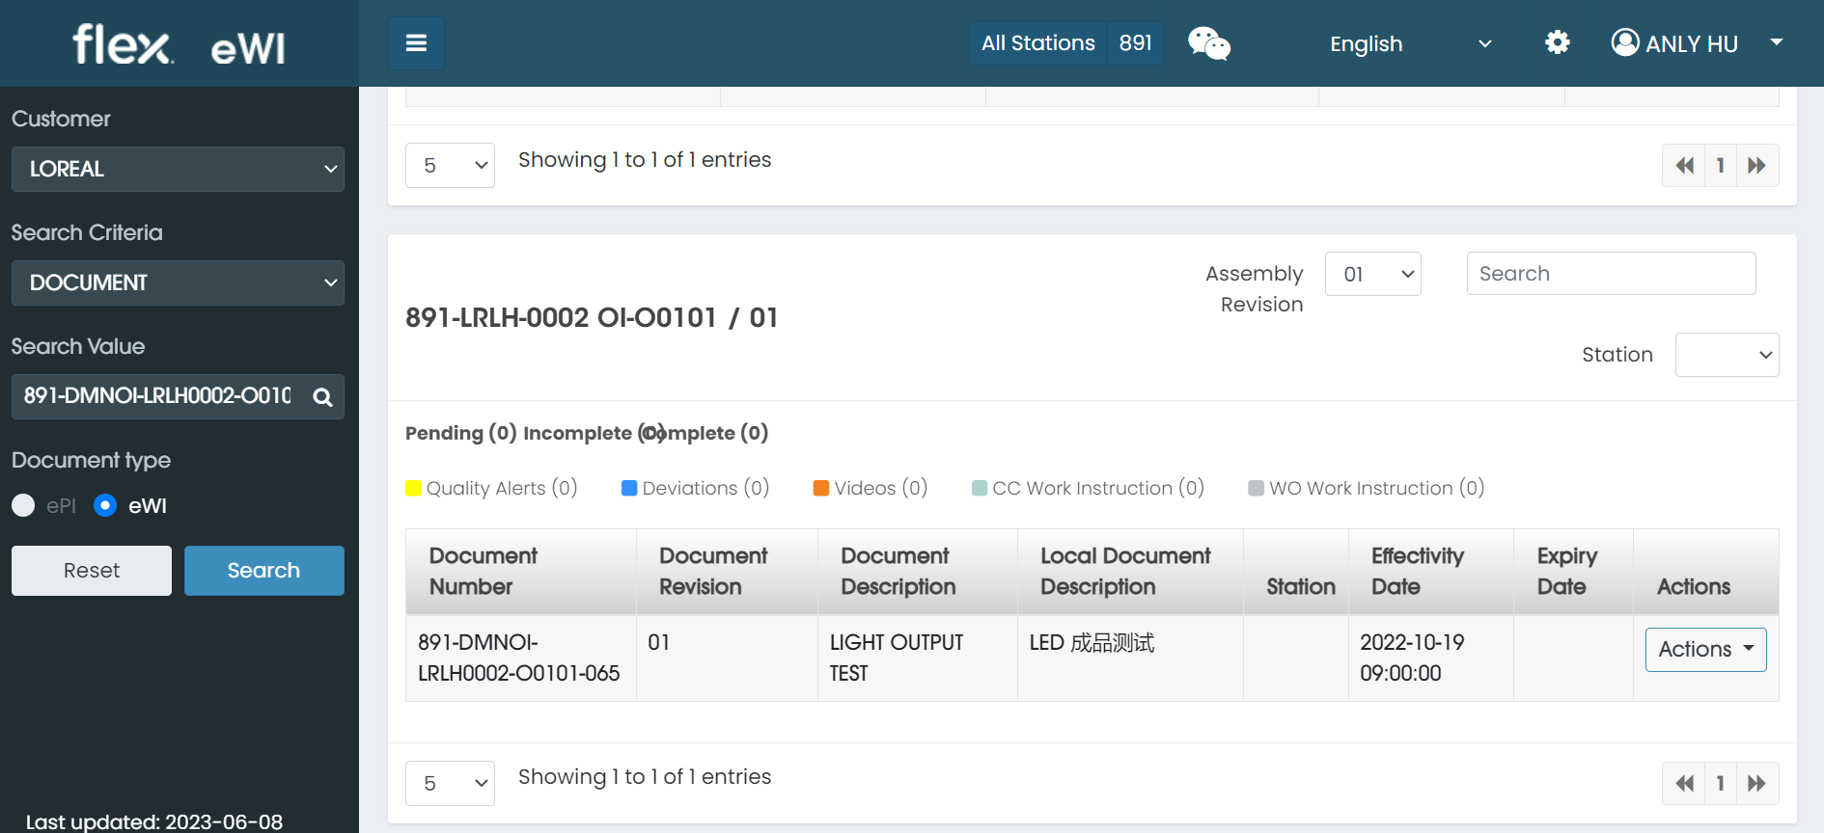
System Using Process 系统使用步骤
How to view documents in E-WI system？ 如何在E-WI系统里面查看文件？
6. When selecting Document, scroll to the bottom of the page, you can see this document, then double-click this document to open.
当选择Document时，拉到页面的下面，可以看到这份文件，然后双击这份文件打开。
Step 3: 拉到页面的下面，可以看到这份文件，然后双击这份文件打开

Slide 23
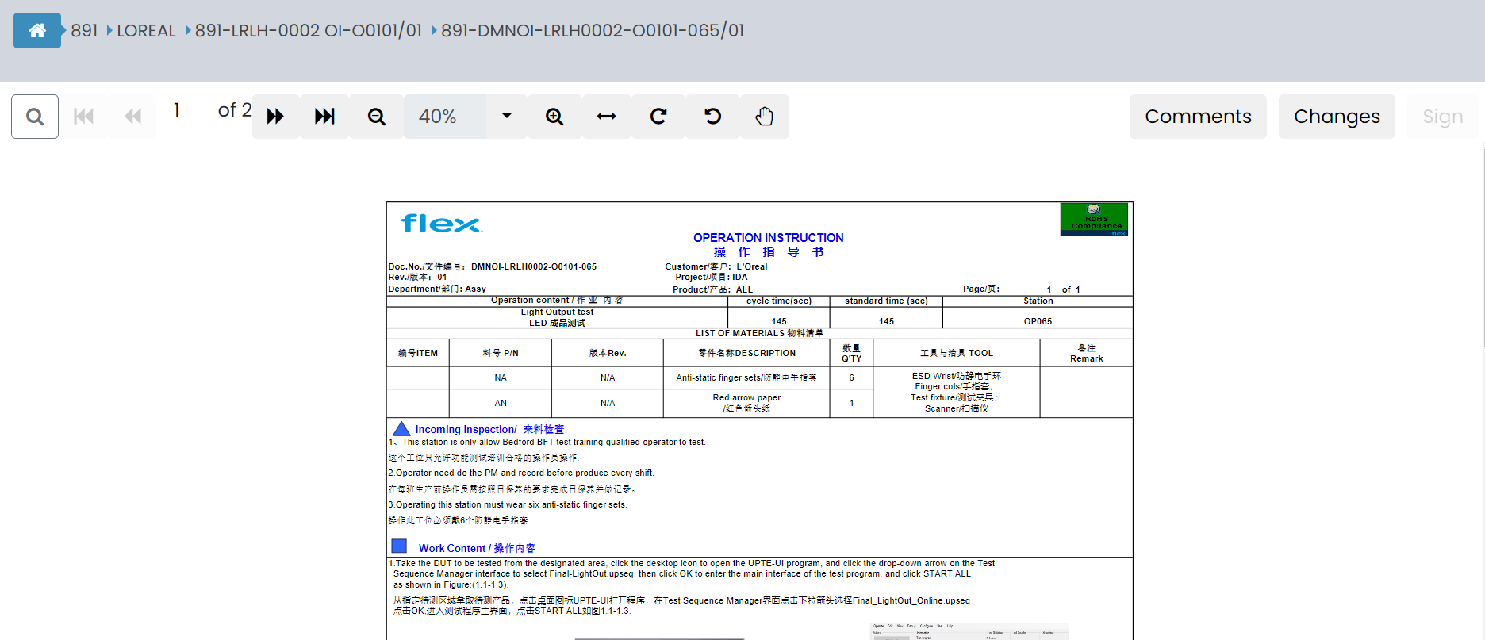
System Using Process 系统使用步骤
Back
How to view documents in E-WI system？ 如何在E-WI系统里面查看文件？
7. Double-click to view the corresponding document.
双击后即可查看相应的文件。

Slide 24
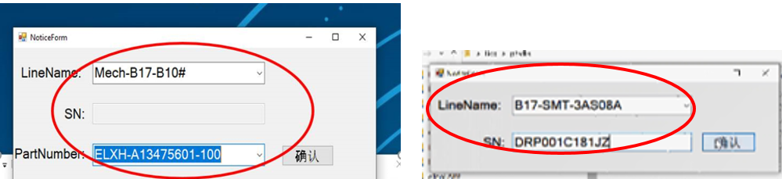
System Using Process 系统使用步骤
Back
How can the production line view WI quickly? 产线如何快捷查看文件？
User select line and scan one SN/Part Number, system will auto trigger to open the line all stations documents.
用户选择线别并扫描SN/料号，系统会自动触发打开该线别的所有文件。

Slide 25
System Using Process 系统使用步骤
Dummy assembly number rule 虚拟料号命名规则
Fill the “Dummy Assembly Number”, the dummy assembly number rule for all projects are as below：
填写“虚拟组装料号”, 所有虚拟组装料号的命名规则参见如下：
The Dummy P/N naming rules that all used uppercase and it’s consisted of “A”, “B”, “C”, “D” four sections, there into section “A” is means ERP#, other three sections “B”, “C”, “D” will change based on the use scope: general or project, document type, Model Code/Department WI and use location, the detailed regulation please refers to “Dummy P/N naming rules list”:
虚拟料号命名规则：全部使用大写字母，虚拟料号由A、B、C、D四部分组成，其中A为ERP代码，B、C、D三部分则根据文件的使用范围：通用或项目、文件类型，型号代码或部门文件、使用位置的不同而改变，详细规则请参考“虚拟料号命名规则清单”：
Non-PIC dummy P/N numbering rule /非PIC虚拟料号命名规则
Remark: H=RoHS, P=GP XXXX=Serial Number from 0001 to 9999 A= the category of chemical (from 1 to 9)
Y=Company code (Refer to DMP-455’s rule of chemical number), X=from A to Z (A is from 01 to 500, B is from 501 to 1000, C is 1001 to 1500, The rest can be done in the same manner.)
备注：H=RoHS, P=GP XXXX=流水号从0001至9999 A=化学品种类（从1至9）Y=公司代码（参考DMP-455的化学品编号规则）,X=从A至Z（A代表从01至500,B代表是501至1000,C代表1001至1501,以此类推）

Slide 26
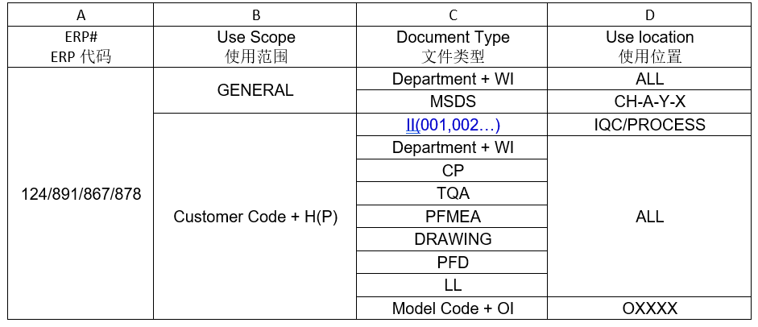
System Using Process 系统使用步骤
Back
Dummy assembly number rule 虚拟料号命名规则
The list of virtual material number naming rules is as follows:
虚拟料号命名规则清单如下：

Slide 27
Thank You

